Slide 1


With
ITC Hotels Revenue Optimization
By – Kartik Pant

Slide 2
Acknowledgement
It is with sincere gratitude that I acknowledge WS-Cube Tech for their invaluable support and guidance throughout the development of my Power BI project on "ITC Hotel Revenue Optimization.“
Their expertise in data analytics and Power BI proved instrumental in navigating the complexities of this project. The resources and insights provided by WS-Cube Tech significantly contributed to the successful completion of this analysis.
I deeply appreciate their commitment to fostering learning and empowering individuals in the field of data science. This project has been an enriching experience, and WS-Cube Tech's contribution was pivotal to its success.

Slide 3
Table of content
About ITC Hotels
Problem Statement
Financial Overview and revenue Performance
Occupancy and Capacity Analysis
Room category Performance and Booking Insights
Cancellation and Lost Revenue Analysis

Slide 4
ITC Hotels
ITC Hotels is an Indian hospitality company that operates and manages hotels. It has over 100 hotels and is India's third largest hotel chain. It has a franchise agreement to operate most of its hotels as part of The Luxury Collection of Marriott International.
ITC Hotels was a subsidiary of ITC Limited until its demerger in 2025. ITC Limited entered the hotel business on 18 October 1975 with the opening of a hotel in Chennai, which was renamed as Welcomhotel By ITC Hotels, Cathedral Road, Chennai.
ITC Hotels has hosted many visiting royalty and world leaders, including George W. Bush, Vladimir Putin, Barack Obama and Donald Trump.
The hotel chain works on a philosophy of "Responsible Luxury” and each hotel in the chain has a LEED (Leadership in Energy and Environmental Design) Platinum rating.
Originally incorporated as Rama Hotels Pvt Ltd in 1972 and renamed Vishwarama Hotels in 1973, the Vazir Sultan Tobacco Co Ltd. (VST Industries) bought Vishwarama Hotels in 1980–1981 and soon after, in 1982, the first luxury hotel for the new chain opened in Bangalore.

Slide 5
ITC Hotels – Problem Statement
ITC Hotels is a luxury hotel chain that operates multiple properties with diverse room categories and varying occupancy rates.
The company wants to gain deeper insights into its overall financial performance, customer booking behavior, occupancy trends, and room category performance to optimize revenue generation, minimize cancellations, and enhance customer satisfaction.
The goal of this project is to create an interactive, multi-page Power BI dashboard to provide stakeholders with real-time insights for decision-making.

Slide 6
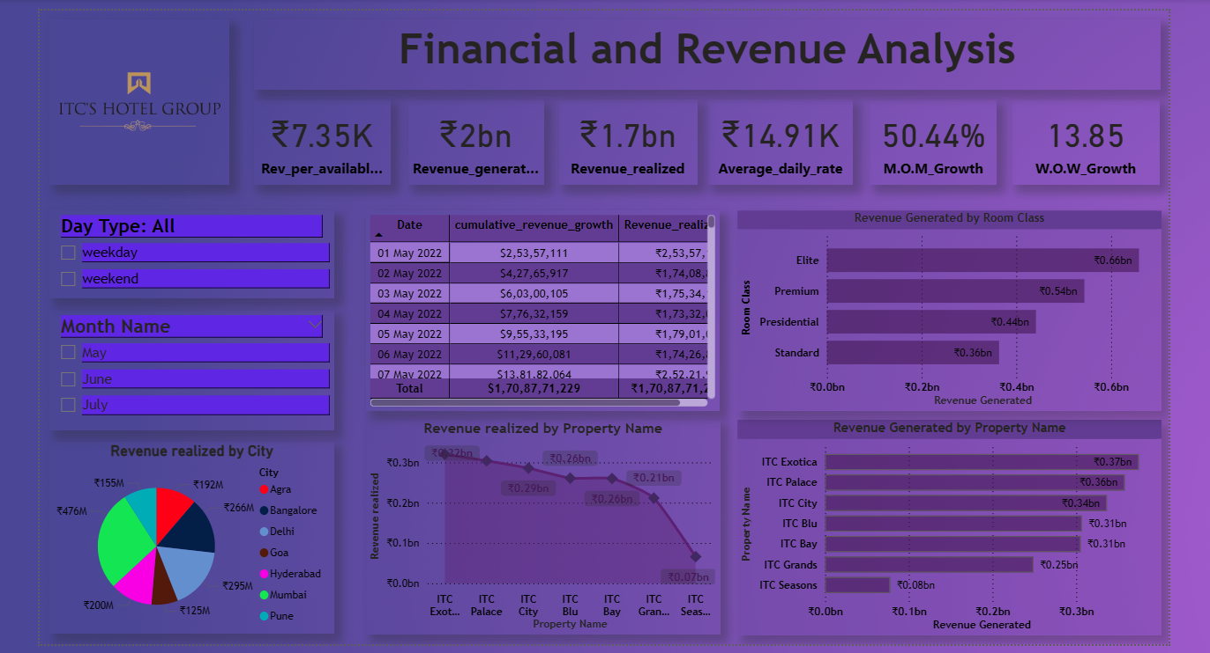
Financial Overview and Revenue Performance

Slide 7
Financial Overview and Revenue Performance
Key Highlights:
Strong Revenue Generation: The total revenue generated stands at ₹2 billion, while the revenue realized amounts to ₹1.7 billion up to May 7, 2022.
Healthy Revenue Per Available Room: The revenue per available room is a robust ₹7.35K, indicating efficient utilization of available inventory.
Solid Average Daily Rate: The average daily rate is ₹14.91K, reflecting the premium positioning and pricing strategy.
Significant Month-over-Month Growth: The month-over-month (M.O.M.) growth in a key metric is a substantial 50.44%, suggesting strong positive momentum.
Positive Week-over-Week Growth: The week-over-week (W.O.W.) growth is also positive at 13.85%, indicating consistent short-term performance improvement.

Slide 8
Financial Overview and Revenue Performance
Revenue Breakdown:
By Room Class: The Elite room class is the highest revenue generator, contributing ₹0.36 billion. Following this are Premium and Presidential at ₹0.4 billion each, and Standard at ₹0.3 billion.
By Property Name: ITC Grands leads in revenue generation among the listed properties at ₹0.25 billion. ITC Palace and ITC City also show significant contributions at ₹0.3 billion and ₹0.34 billion, respectively.
By City: Mumbai is the top revenue-generating city at ₹476M. Bengaluru also shows strong performance at ₹266M, followed by Delhi at ₹256M. Hyderabad and Chennai contribute ₹219M and ₹125M, respectively. Goa generates ₹192M in revenue.

Slide 9
Financial Overview and Revenue Performance
Trends and Observations:
The cumulative revenue shows a steady upward trend throughout the analyzed period (May 1st to May 7th, 2022).
The revenue realized by property name appears to show a slight dip towards the end of the analyzed period for some properties, as indicated by the trend line.
Overall, the dashboard indicates a strong financial performance with significant revenue generation and positive growth trends. Mumbai and Bengaluru are key revenue-generating cities, while the Elite, Premium, and Presidential room classes are the major contributors to room revenue. ITC Grands, ITC Palace, and ITC City are the top-performing properties in terms of revenue generation.

Slide 10
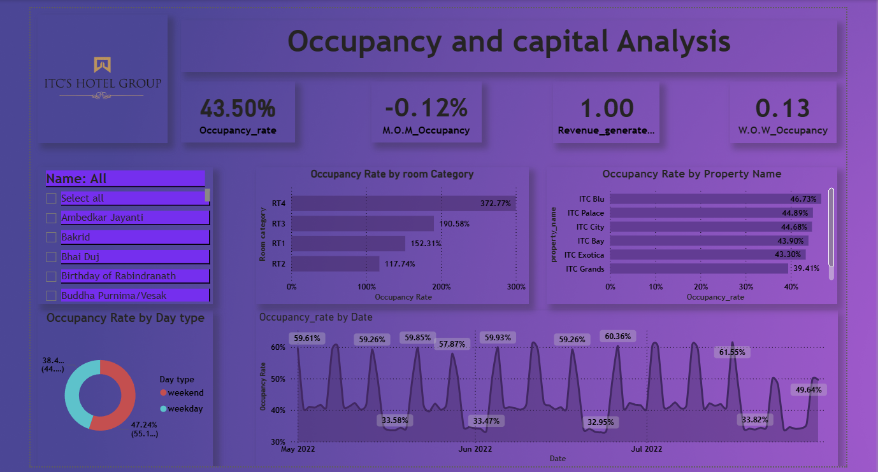
Occupancy and Capacity Analysis

Slide 11
Occupancy and Capacity Analysis
Key Highlights:
Moderate Overall Occupancy: The overall occupancy rate stands at 43.50%.
Slight Month-over-Month Occupancy Decline: There is a marginal month-over-month (M.O.M.) decline in occupancy of -0.12%.
Efficient Revenue Generation: The revenue generated per unit of capital is 1.00, indicating efficient asset utilization in generating revenue.
Marginal Week-over-Week Occupancy Growth: The week-over-week (W.O.W.) growth in occupancy is slightly positive at 0.13%.

Slide 12
Occupancy and Capacity Analysis
Occupancy Breakdown:
By Room Category: There is significant variation in occupancy across room categories. RT4 exhibits the highest occupancy at 372.77%, which is unusually high and likely indicates a data anomaly or a specific interpretation of this category (e.g., overbooking or a different unit of measurement). RT3 also shows a high occupancy at 190.58%. RT1 has an occupancy of 152.31%, and RT2 at 117.74%. These figures above 100% warrant further investigation to understand the underlying reasons.
By Property Name: ITC Blu has the highest occupancy rate among the listed properties at 46.73%. ITC Palace follows at 44.89%, and ITC City at 44.68%. ITC Bay has an occupancy of 43.90%, ITC Exotica at 43.20%, and ITC Grands has the lowest occupancy at 39.41%.
By Day Type: Weekends show a significantly higher occupancy rate of 47.24% compared to weekdays at 38.41%.

Slide 13
Occupancy and Capacity Analysis
Occupancy Trends Over Time:
The occupancy rate by date fluctuates between approximately 32% and 61% during the May to July 2022 period.
There are noticeable peaks in occupancy, particularly around weekends, as indicated by the higher occupancy on specific dates.
Occupancy appears to generally be higher in late May and early June, with some dips in late June and a recovery in July.
Overall, the dashboard reveals a moderate overall occupancy rate with a slight month-over-month decline. Revenue generation efficiency appears strong. Weekends drive significantly higher occupancy compared to weekdays. There is substantial variation in occupancy across different room categories, with some categories showing unusually high percentages that require further scrutiny. Among the properties, ITC Blu, ITC Palace, and ITC City exhibit the highest occupancy rates.

Slide 14
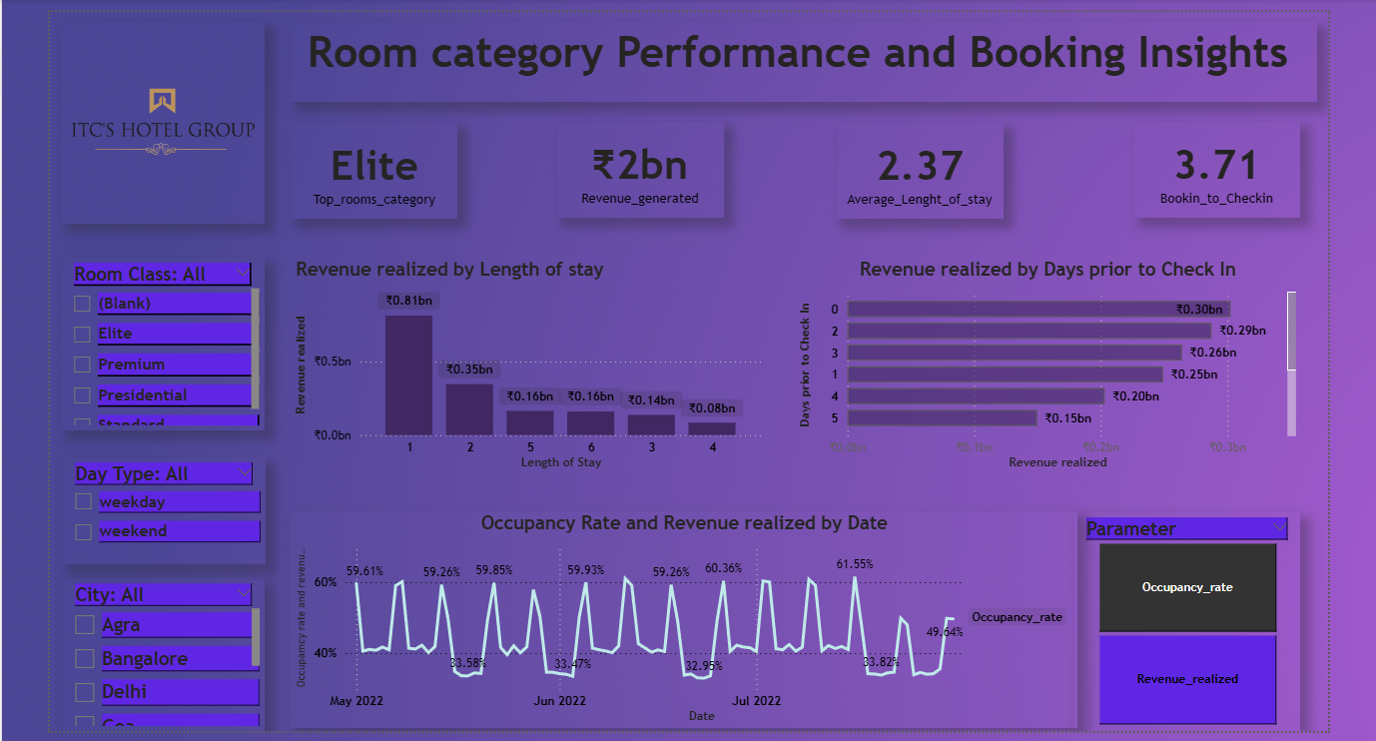
Room Category Performance and booking insights

Slide 15
Room Category Performance and booking insights
Key Highlights:
Elite is the Top Performing Room Category: The Elite room category is highlighted as the top rooms category.
Significant Revenue Generation: The total revenue generated is ₹2 billion across all room categories.
Moderate Average Length of Stay: The average length of stay is 2.37 nights.
Reasonable Booking Lead Time: The average booking to check-in time is 3.71 days.

Slide 16
Room Category Performance and booking insights
Revenue Breakdown by Length of Stay:
The highest revenue realized is for stays of 1 night, amounting to ₹0.55 billion.
Stays of 2 nights also contribute significantly with ₹0.35 billion in revenue realized.
Revenue realized decreases for longer stays, with 3-night stays generating ₹0.16 billion, 4-night stays at ₹0.14 billion, and 5-night stays at ₹0.08 billion.

Slide 17
Room Category Performance and booking insights
Revenue Breakdown by Days Prior to Check-in:
Bookings made 0 days prior to check-in (same-day bookings) generate the highest revenue at ₹0.30 billion.
Bookings made 1 day prior contribute ₹0.29 billion, and 2 days prior also generate ₹0.29 billion.
Revenue realized decreases for bookings made further in advance, with 3 days prior at ₹0.25 billion, 4 days prior at ₹0.20 billion, and 5 days prior at ₹0.15 billion.

Slide 18
Room Category Performance and booking insights
Occupancy Rate and Revenue Realized by Date:
The occupancy rate fluctuates between approximately 32% and 61% during the May to July 2022 period, showing a similar trend to the previous occupancy dashboard with peaks around weekends.
The revenue realized by date generally follows a similar pattern to occupancy, with higher revenue on dates with higher occupancy.
Overall, the Elite room category is the top revenue generator. The majority of revenue comes from shorter stays (1-2 nights) and bookings made closer to the check-in date (0-2 days prior). Occupancy and revenue realized show similar trends over time, with weekend peaks.

Slide 19
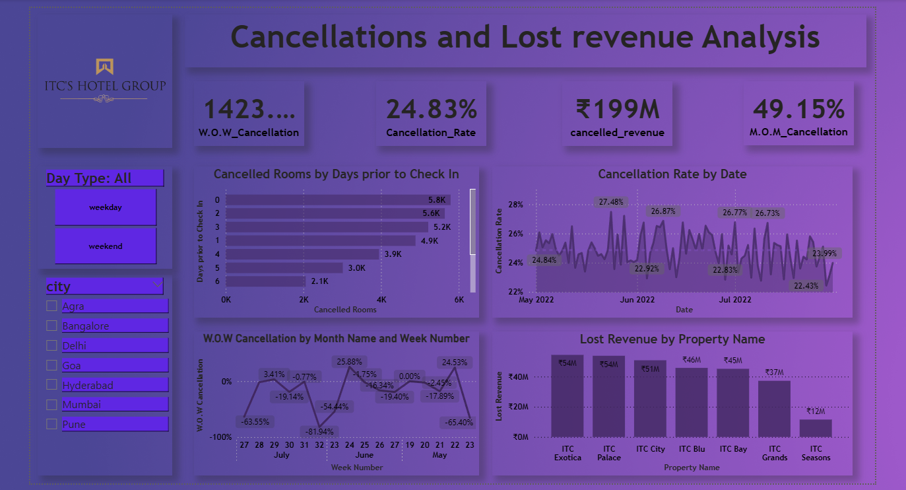
Cancellation and Lost Revenue Analysis

Slide 20
Cancellation and Lost Revenue Analysis
Key Highlights:
Significant Week-over-Week Cancellation Increase: There is a substantial week-over-week (W.O.W.) increase in cancellations of 1423%. This drastic increase warrants immediate investigation to understand the underlying causes.
Moderate Overall Cancellation Rate: The overall cancellation rate is 24.83%.
Substantial Cancelled Revenue: The total cancelled revenue amounts to ₹199 million, representing a significant financial impact.
High Month-over-Month Cancellation Increase: The month-over-month (M.O.M.) increase in cancellations is a significant 49.15%, indicating a worsening trend in cancellations.

Slide 21
Cancellation and Lost Revenue Analysis
Cancelled Rooms by Days Prior to Check-in:
The highest number of cancelled rooms occurs for bookings made 0 days prior to check-in (same-day cancellations) at 5.8K.
Cancellations are also high for bookings made 1 day prior (5.4K) and 2 days prior (5.2K).
The number of cancelled rooms generally decreases as the booking lead time increases.

Slide 22
Cancellation and Lost Revenue Analysis
Cancellation Rate by Date:
The cancellation rate fluctuates throughout the period, ranging from a low of around 22% to a high of nearly 28%.
There appear to be peaks in the cancellation rate around late May and mid-June.
The cancellation rate shows a slight decrease towards the end of July.

Slide 23
Cancellation and Lost Revenue Analysis
Week-over-Week Cancellation by Month Name and Week Number:
There are significant fluctuations in week-over-week cancellations. Notably, there are substantial increases in cancellations in certain weeks of May (Week 19, 20, 22, 23) and July (Week 27).
Conversely, some weeks show a decrease in cancellations. The large positive W.O.W. cancellation figure of 1423% likely stems from a specific week-over-week comparison within this timeframe.

Slide 24
Cancellation and Lost Revenue Analysis
Lost Revenue by Property Name:
ITC Exotica experienced the highest lost revenue at approximately ₹48M.
ITC Palace follows with a significant lost revenue of around ₹54M.
ITC City also shows substantial lost revenue at approximately ₹45M.
ITC Grands incurred a lost revenue of around ₹37M.
ITC Bay had a lost revenue of approximately ₹17M.
ITC Seasons experienced the lowest lost revenue among the listed properties at around ₹12M.
Overall, the dashboard highlights a concerning trend of increasing cancellations, particularly the very high week-over-week increase. A substantial amount of revenue has been lost due to cancellations, with ITC Exotica and ITC Palace experiencing the highest impact. Same-day and next-day cancellations contribute significantly to the total number of cancelled rooms.

Slide 25
Conclusion of the ITC Hotel Revenue Optimization Project
Based on the analysis of the provided dashboards spanning from May to July 2022, several key conclusions can be drawn regarding ITC Hotels' revenue optimization:
Strong Revenue Generation but Untapped Potential: While the hotel group demonstrates robust revenue generation (₹2 billion), there are clear opportunities to further optimize revenue through a deeper understanding of booking patterns, room category performance, and cancellation drivers.
Elite Room Category Drives Revenue: The Elite room category stands out as the top revenue generator, suggesting a strong demand and potentially the possibility of premium pricing strategies or upselling efforts.
Short Stays and Last-Minute Bookings Dominate: A significant portion of revenue comes from shorter stays (1-2 nights) and bookings made close to the check-in date (0-2 days prior). This highlights the importance of effectively managing inventory and pricing for these booking windows.
Weekends are Key for Occupancy: Weekends consistently exhibit significantly higher occupancy rates compared to weekdays, underscoring the need for targeted strategies to boost weekday occupancy.

Slide 26
High Cancellation Rates and Significant Lost Revenue are Major Concerns: The most critical area requiring attention is the high overall cancellation rate (24.83%) and the substantial lost revenue (₹199 million). The dramatic week-over-week and month-over-month increases in cancellations are particularly alarming and demand immediate investigation.
Last-Minute Cancellations are Prevalent: A significant number of cancellations occur very close to the check-in date, indicating potential issues with booking flexibility, deposit policies, or unforeseen circumstances impacting travelers.
Property-Specific Cancellation Impact: The impact of lost revenue due to cancellations varies significantly across properties, with ITC Exotica and ITC Palace experiencing the highest losses. This suggests the need for tailored cancellation management strategies at the property level.
Data Anomalies Require Investigation: The unusually high occupancy rates reported for certain room categories (RT4, RT3, RT1, RT2) warrant a thorough data quality check to ensure accurate interpretation and analysis.

Slide 27
Thank you

